Slide 1
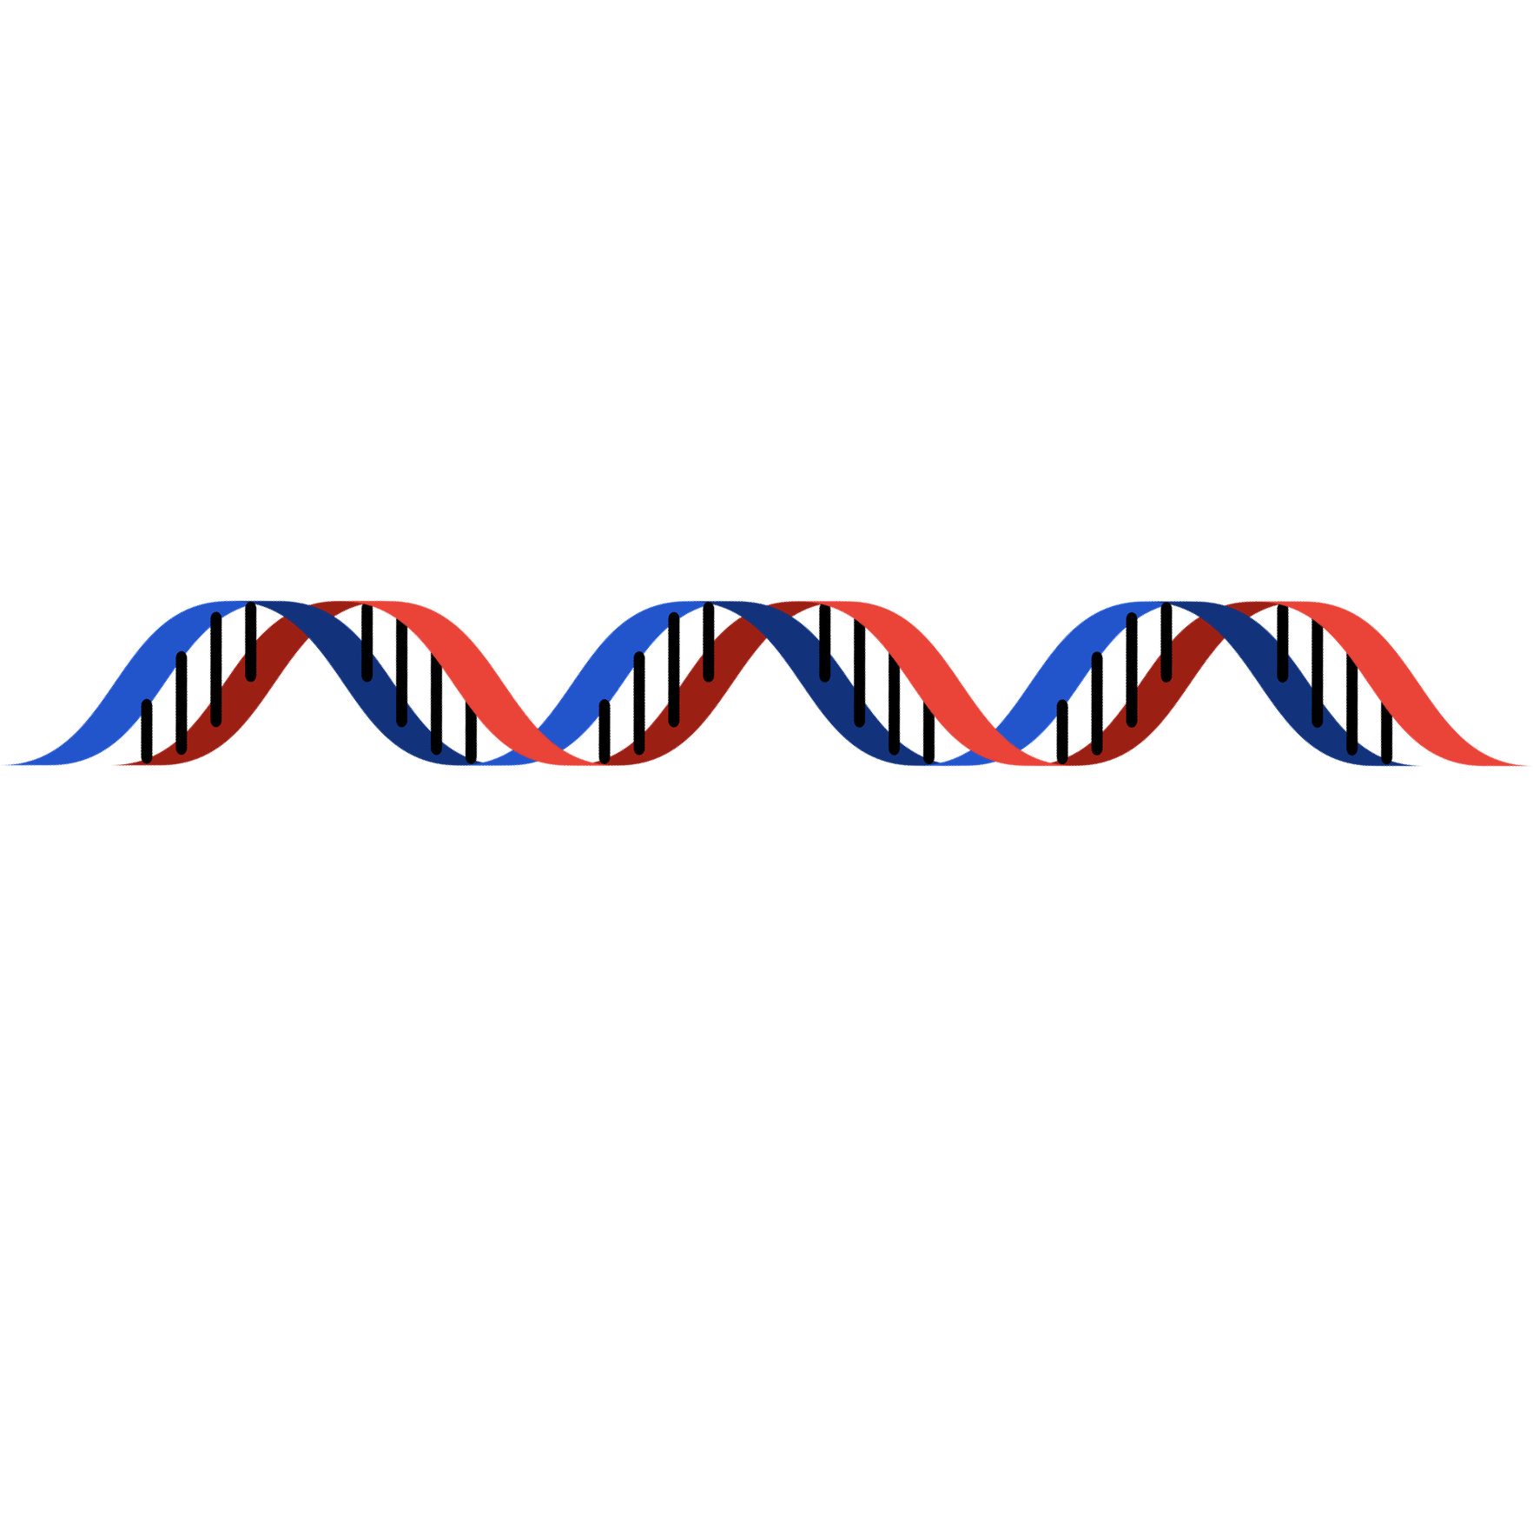
DNA Extraction
Brooke Wolford, PhD
April 27, 2021

Slide 2
What does a scientist do?

Slide 3
DNA makes you, you

Slide 4
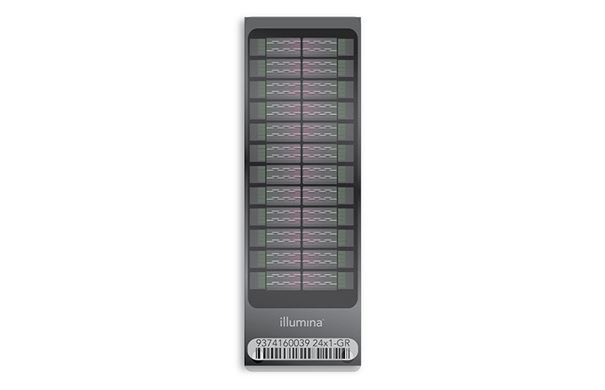
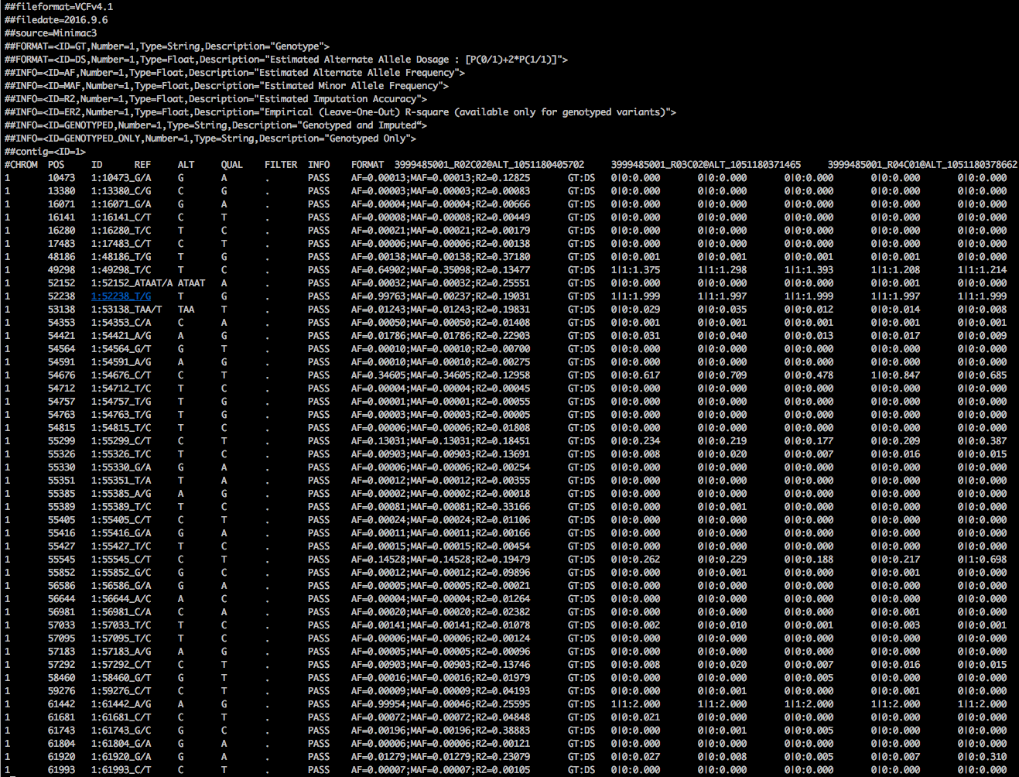
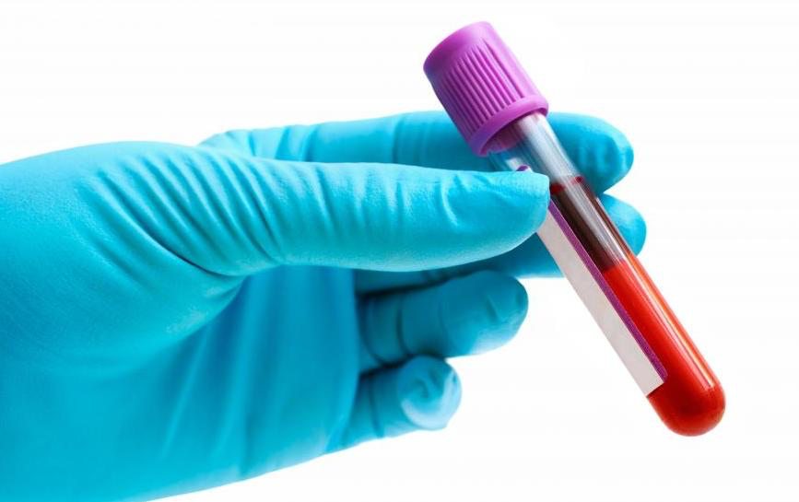
We can read the DNA in your cells
Sample collection
Genotyping array
Genotypes in digital format

Slide 5
We can read the DNA in your cells
T
A
C
G

Slide 6
How tall is the human genome if you print it on paper?
424 feet
305 feet
Notes:
The human genome consists of approximately 3.1467 billion base pairs (a number just slightly less than the number of seconds in 100 years: 3.15576 billion). Thus, 1,206,980 single-sided sheets would be needed to display the entire human genome in this way. A modern ream of printer paper consists of 500 sheets of paper and is about 2.1" (5.33 cm) thick. One would therefore need to use 2,414 reams of paper to print the human genome in the format just described. A stack of that many reams of paper would stand 424.4 feet (129.36 m) tall, approximately midway in height between the Statue of Liberty and the Washington Monument:
http://bio4.us/biotrends/human_genome_height.html
So how do you think we can read through all these sheets of paper?
If you had to find a specific letter on chromosome 3 for me, how would you do it?

Slide 7
What if you knew every one of the 3 billion letters in every genome of 1 million people?
x 1,000,000
Notes:
This is the importance of computers plus code!

Slide 8
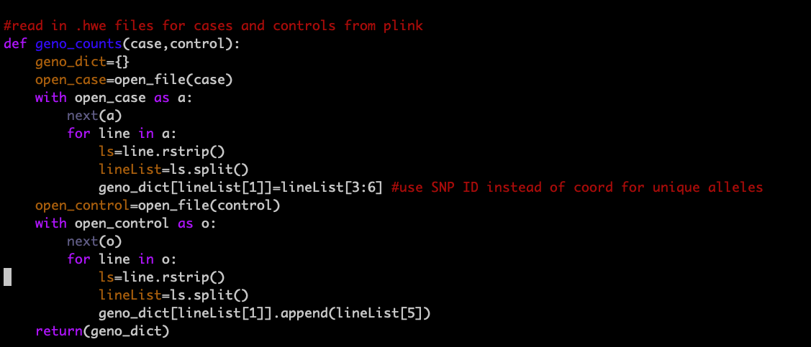
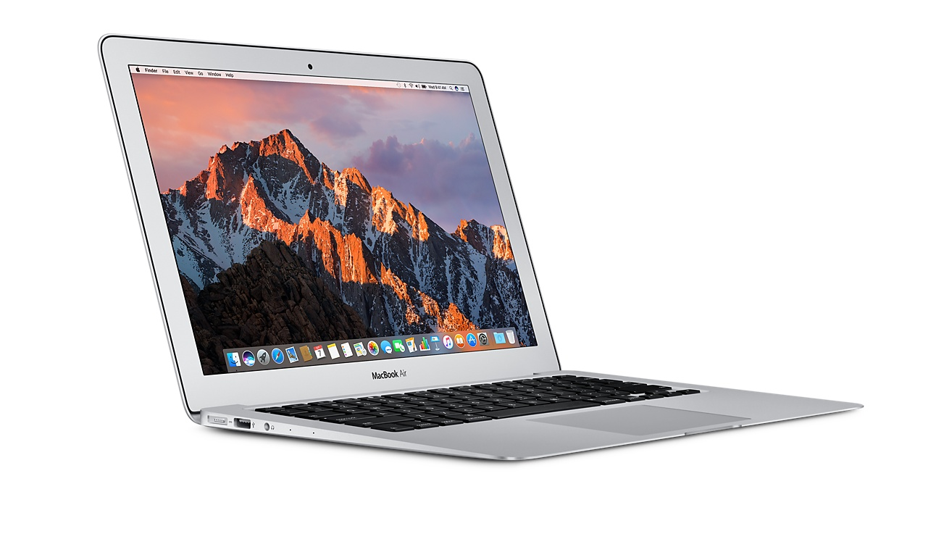
Big data + Computers + Code

Slide 10
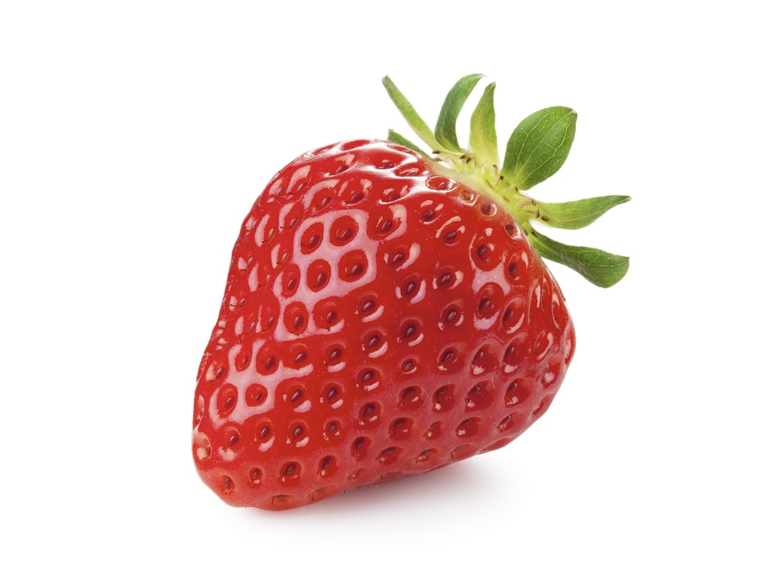
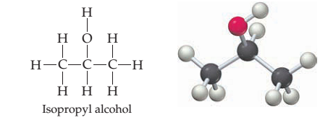
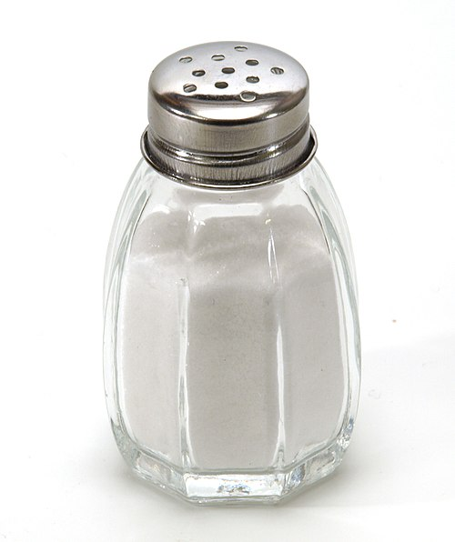
Today, let’s extract DNA from a strawberry!
+
+
Wikimedia
Chegg
Thermofisher

Slide 11
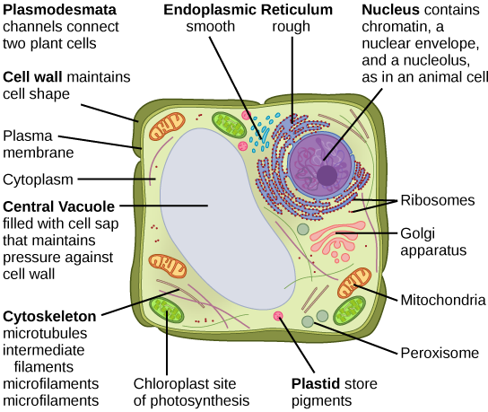
DNA
Wikimedia
Notes:
https://drive.google.com/file/d/1GM-ayAMoh3i2fbCuzLdF6X6VlrLURdGQ/view?usp=sharing

